Slide 1
EDA on COVID-19 Dataset
Exploratory Data Analysis and Visualization of COVID-19 Data
SHREYA JOSE
SNEHA K
SREENANDU PRDEEP
SRUTHIKA S
TEJASWINI PRASHANTH
TOMLIN T SUNNY

Slide 2
Introduction
COVID-19 generated extensive data on confirmed cases, recoveries, and deaths across different regions. Analyzing this data helps us understand how infection patterns and rates changed over time.
Exploratory Data Analysis (EDA) is used to examine, summarize, and visualize data to discover meaningful patterns and trends.
This project applies EDA techniques to the COVID-19 dataset to analyze the data and identify important trends and infection patterns across different regions.

Slide 3
Objectives
  To understand and explore the COVID-19 dataset.
  To clean and preprocess the available data.
  To analyze COVID-19 infection patterns and rates.
  To identify important trends and relationships in the data.
  To visualize the data using suitable charts and graphs.
  To derive meaningful observations from the analysis

Slide 4
Dataset
The project uses a COVID-19 dataset containing information related to the spread and impact of the disease across different regions.
The dataset includes information such as:
  Confirmed COVID-19 cases
  Recoveries
  Deaths
  Geographical/region-wise information
  Other relevant COVID-19 statistics available in the dataset

Slide 5
Python
Primary programming language used for data analysis.
Pandas
Used for data loading, cleaning, manipulation, and analysis.
Tools and Technologies
Matplotlib
Used to create graphs and charts for data visualization.
Google Colab
Used as the environment for writing and executing the Python analysis.

Slide 6
Methodology
The analysis is carried out through the following steps:
  Data Collection
Obtain the COVID-19 dataset for analysis.
  Data Loading
Import the dataset into Google Colab using Pandas.
  Data Cleaning
Check for missing values, duplicate records, and inconsistencies in the data.
  Data Exploration
Examine the structure, columns, and statistical characteristics of the dataset.
  Data Analysis
Analyze cases, recoveries, deaths, infection rates, and regional patterns.
  Data Visualization
Represent important findings using graphs and charts with Matplotlib and Seaborn

Slide 7
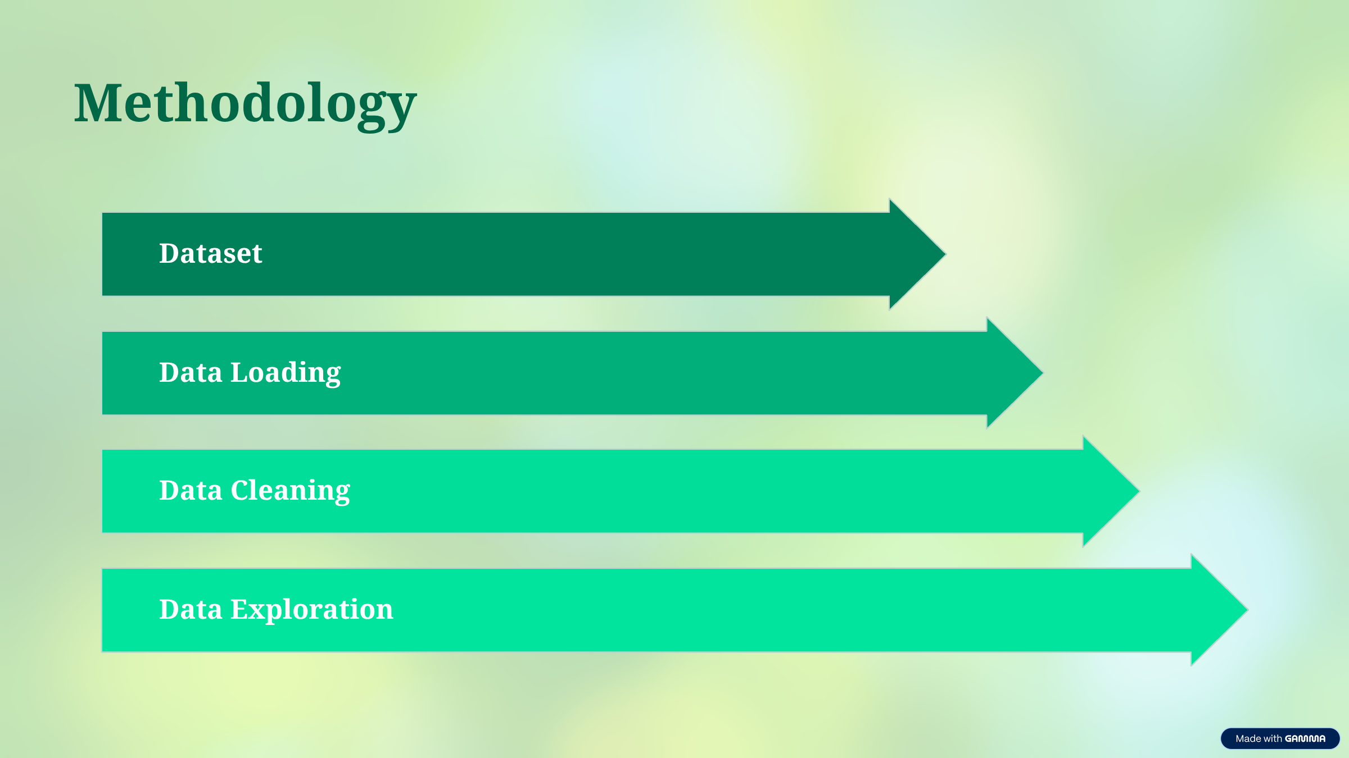

Slide 8
Data Cleaning and Analysis
Data Cleaning | Data Analysis
Checked the dataset for missing values. Identified and handled duplicate records. Checked data types and corrected inconsistencies where required. Prepared the data for further analysis. | Examined the distribution of COVID-19 cases. Compared confirmed cases, recoveries, and deaths. Analyzed regional differences in COVID-19 impact. Calculated relevant rates and summary statistics. Identified patterns and trends from the dataset.

Slide 9
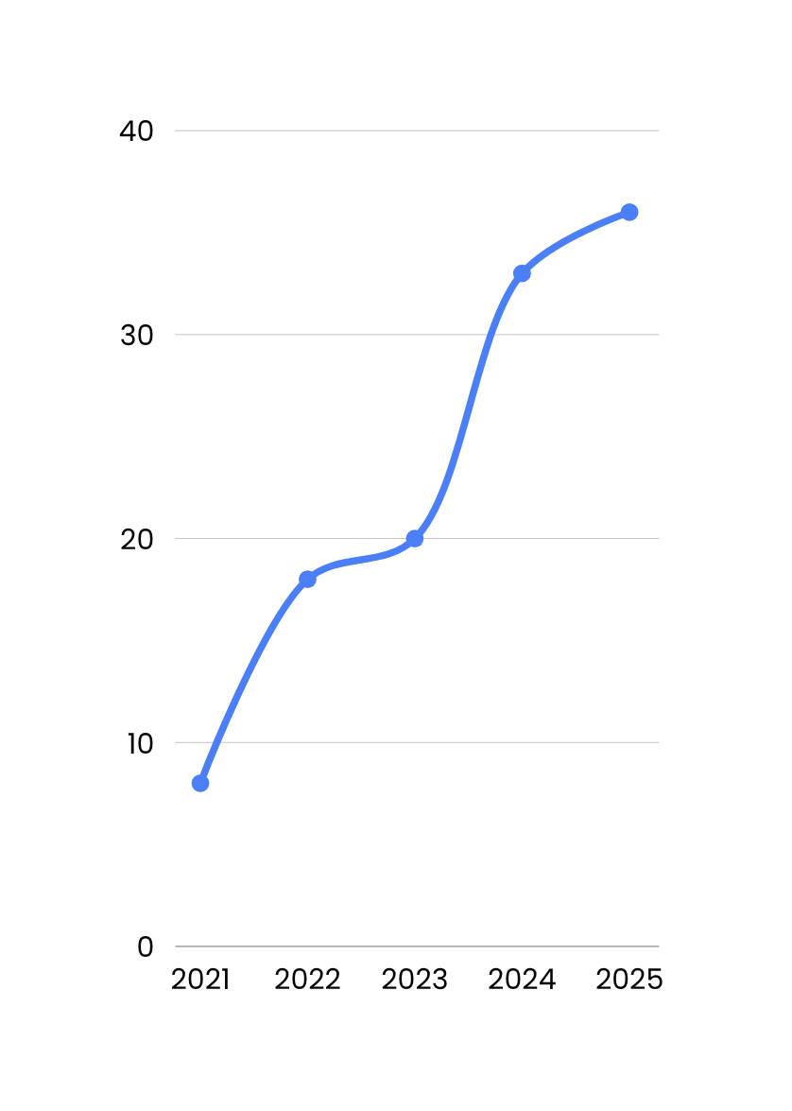
Data Visualization
Data visualization helps present the analyzed COVID-19 data in a clear and understandable form. Different types of graphs can be used to identify trends, compare values, and understand relationships between variables.
The visualizations used may include:
  Line Charts
  Bar Charts
  Scatter Plots
  Heatmaps .

Slide 10
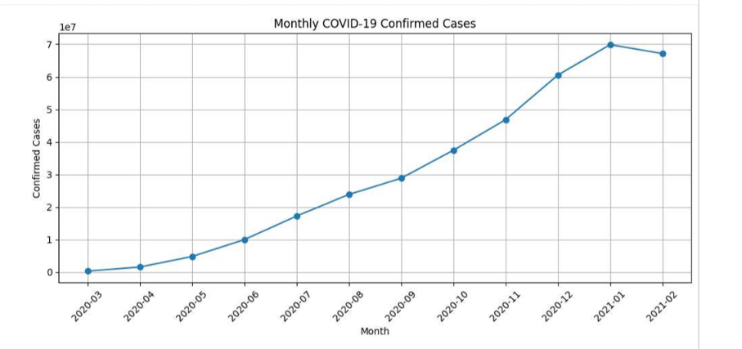
Results

Slide 11
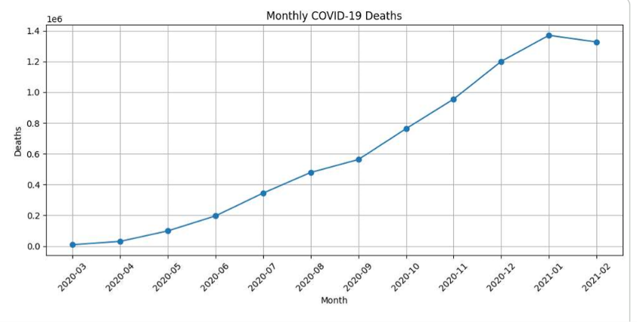
Results

Slide 12
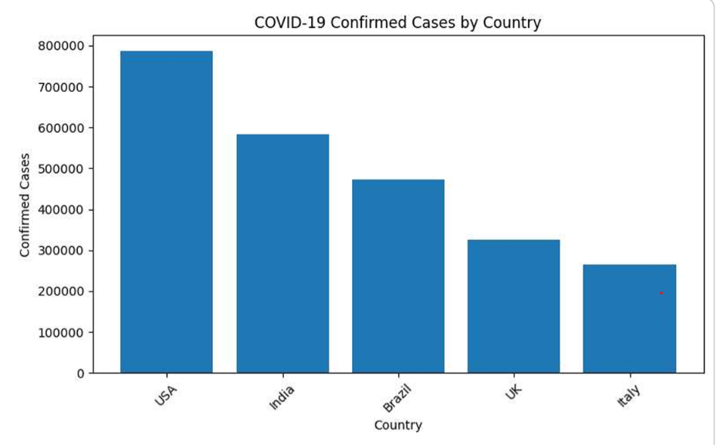
Results

Slide 13
Conclusion
  Exploratory Data Analysis helped us understand the COVID-19 dataset.
  Data cleaning and preprocessing improved the quality of the analysis.
  Statistical analysis and visualization helped identify important COVID-19 patterns and trends.
  Different graphs provided a clear representation of cases, recoveries, deaths, and regional variations.
  The analysis demonstrates how data visualization can support better understanding of large datasets.

Slide 14
Thank You

